Slide 1


Office of Measurement Services
We provide expertise that allows our clients to focus on theirs.

Slide 2


Overview
Introduction
OMS & Qualtrics
Qualtrics Uses:
Peer feedback
Quotas & trigger functions in Qualtrics
Contact info and resources

Slide 3

Tiffany Thayer
Project Manager
Qualtrics Programmer & Investigator
Online Survey Awareness & Outreach

Slide 4
OMS & Qualtrics
Qualtrics is the preferred online survey tool of the University of Minnesota because it meets stringent information security requirements not found in most free online survey tools.
The Office of Measurement Services (OMS) is the Business Owner of Qualtrics and works in cooperation with the Office of Information Technology (OIT) to resolve user issues, set system requirements, and maintain the survey.umn.edu website.
OMS is the liaison between Qualtrics users, our Qualtrics Sales Representative, OIT, and the University Survey Advisory Team.

Slide 5


Peer Feedback via Qualtrics

Slide 6
Online Peer Feedback Reviews
Client Needs:
Qualtrics Functions Used:
Ability to administer an online peer feedback review for 4 different groups within the course
Confidential responses
Only allow students to give feedback on those in their group
Individual reports for the instructor.
Detailed panel with which students were in what group.
Survey display logic based on group selection
Open link with restricted access (SSO and panel)
Email Triggers with individual reports

Slide 7

Quotas & Triggers

Slide 8

Quotas and Email Triggers
Needs:
Qualtrics Functions Used:
Ability to put caps/limit on event sessions. Monitor capacity.
Registration email confirmation with sessions attendees selected.
Quota function (Edit Survey>Advanced Options>Quotas)
Email triggers (set condition, pipe in text selected answers, and pipe in email address from registration field in the registration survey)

Slide 9
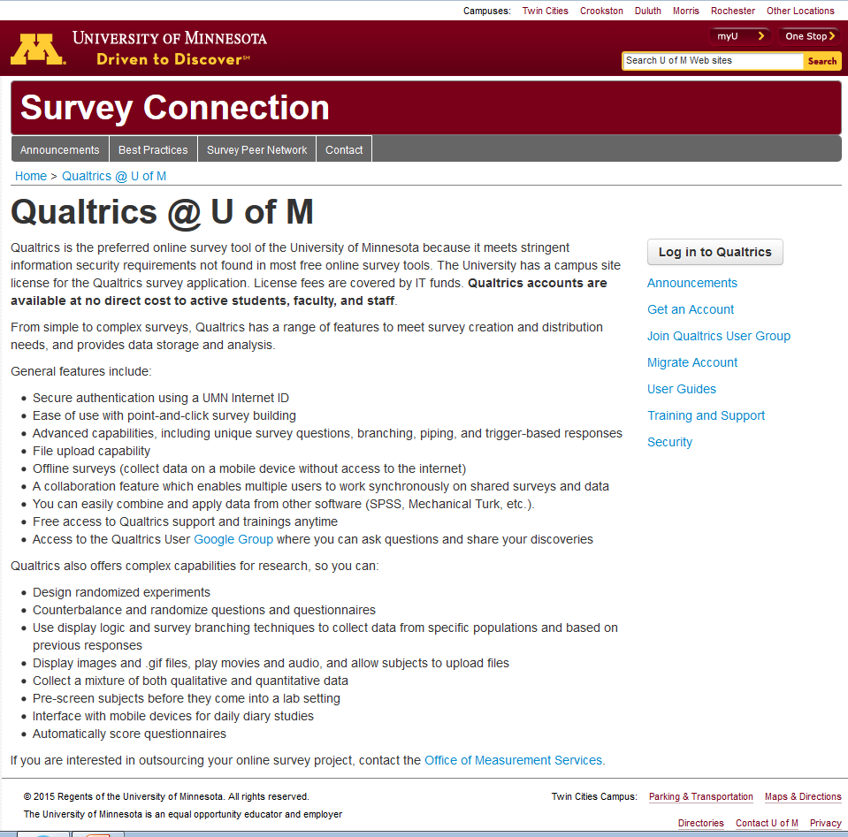
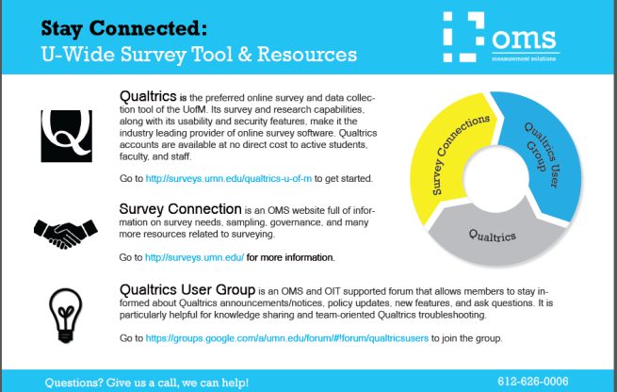
Qualtrics Resources at the UofM
Qualtrics helpline:
800-340-9194
support@qualtrics.com
Stay Connected Handout
Surveys.umn.edu
Join the Qualtrics User Group
Fill out a Qualtrics Consulting Request Form

Slide 10
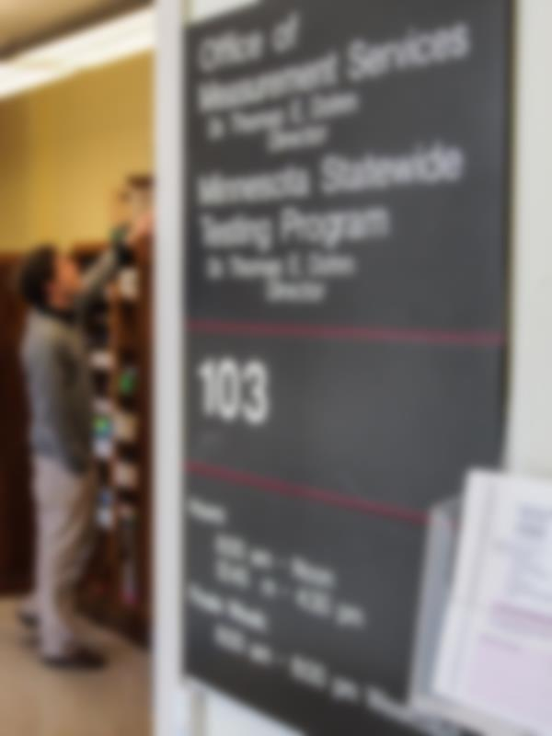

Surveys.umn.edu
612-626-0006 oms.umn.edu

